Slide 1
BST

Slide 2
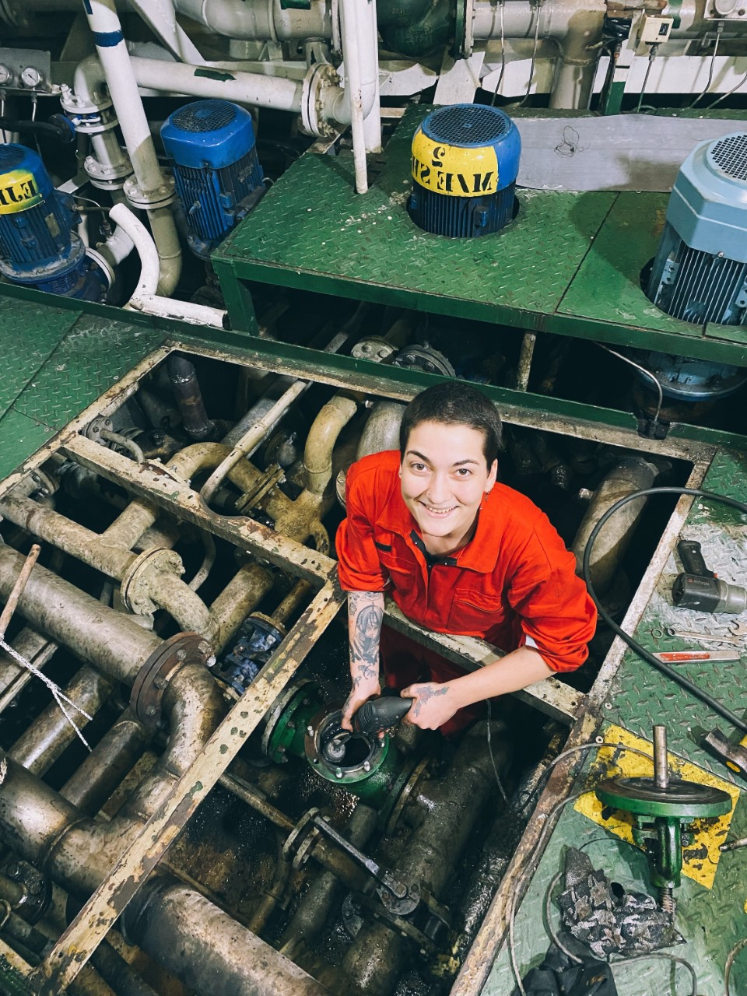
theseafarerscharity.org

Slide 3
The port-based welfare needs of women seafarers
Professor Helen Sampson
Seafarers International Research Centre
School of Social Sciences
Cardiff University
theseafarerscharity.org

Slide 4
Because of their minority status women face a very particular situation on board cargo ships
Made to feel unwelcome
Needs are not met (PPE and menstruation)
Socially excluded as a consequence of masculine behaviours – jokes and pornography
Socially isolate themselves to avoid gossip and harassment
Live in fear of assault from colleagues
May have experienced assault and feel unable to report it
theseafarerscharity.org

Slide 5
Feeling unwelcome
‘I have experienced a lot of crew mates that still think that […] This is not a world for you, this is not an industry for you, it’s always like that’. (Marni, Rating, Asia)
theseafarerscharity.org

Slide 6
‘My department head, […] he doesn’t like female onboard because according to him female onboard is like a liability. He seems to dislike me. […] He directly told me that he doesn’t like having females onboard’. (Arni, Officer, Asia)
‘I don’t have any choice but to meet them, to see them every day and be reminded that they don’t like me onboard’. (Sandra, Rating, Asia)
theseafarerscharity.org

Slide 7
Ways women are excluded on board: their needs are invisible/unmet e.g. no PPE
‘The size is too big, it is men’s size, what do I expect? […]Even the shoes […] So, I have blisters on my feet on the first few months’. (Sandra, rating, Asia)
theseafarerscharity.org

Slide 8
Exclusion; no provision for menstruation
‘There’s chips, there’s snacks, there’s drink. There’s a lot of other things. No not sanitary napkins’.(Rosa, Officer, Asia)
‘I told my captain, he was also Panamanian. I said: captain maybe next time you will have in the slop chest, sanitary napkin because you have two females onboard. And then he was just laughing’. (Ethel, Officer, Asia)
theseafarerscharity.org

Slide 9
‘There’s no sanitary products […] but whenever I’ve suggested it in meetings, they’ve all always nodded their heads and said it’s a good idea, but it’s never actually taken anything any further’. (Rowna, Officer, European)
theseafarerscharity.org

Slide 10
No provision for sanitary disposal
‘My biggest problem was to always how to get rid of sanitary towels and things’. (European officer)
theseafarerscharity.org

Slide 11
Lack of facilities could lead to conflict and humiliation
It was part of the meeting too. [..] there are some troubles in the pipes, so they ask the girls, ‘how do you throw your pads, do you flush it’? […] So, [I told them] ‘I put it in my own trash can’. [They asked] ‘Where?’. I said, ‘of course I don’t display it. It’s hidden in the bathroom or somewhere’. They ask the messman too, during the meeting they are very open. ‘Have you seen it?, You have any problems?’ (Susan, Officer, Asia)
theseafarerscharity.org

Slide 12
Exclusion from social life on board
‘They joke a lot about sexual things’.
‘I told him, ‘Maybe you forgot that I am a female’. ‘ […] So, he just tried to laugh and he took it as me having a bad attitude. […] Then the other day, the second time he said the same kind of joke, […] the next day, he is still joking. He said, ‘okay we will do the joking later because Jen is here.’ ‘Jen officer Asia)’.
theseafarerscharity.org

Slide 13
‘They want to watch those videos in public and they will be in group then I just have to set myself apart […] oftentimes, very oftentimes. […] they are still fond of watching those stuffs’. (Mira, Officer, Asia)
theseafarerscharity.org

Slide 14
The production of fear - harassment and assault
‘He put his arm around me, and he started playing with my ear and I just sort of froze and thought ‘what’s he doing[…] I went to my cabin and there was a knock on the door. So, I opened it and he came straight in and stuck his tongue in my mouth. In my mind, that was really clear, I haven’t done anything to ask for that… But even then I didn’t say anything to anyone...you think of these people’s family back home and stuff’. (Emily, officer, Europe)
theseafarerscharity.org

Slide 15
‘There was another one who cornered me into this pantry. I was just putting my plate and he came and I couldn’t go out, he was asking for a kiss or to be touched and he was showing me his private parts already[…]I didn’t tell anybody about it’. (Paula, Officer, Asia)
theseafarerscharity.org

Slide 16
‘I am the type of person who does not complain as long as I can tolerate it […] there are lots of seafarers, neophytes who lost their lives at sea, you know, committed suicide or pushed in the middle of the ocean. I don’t want that to happen to me, so I just kept my complaints to myself’. (Matilde, Officer, Asia)
theseafarerscharity.org

Slide 17
Being alone with the problem
‘One senior officer tried to harass me… he also entered the room and then locked the door then he wanted to kiss me. I said no, I pushed him and then I go to bosun, and I tell them that I will not stay there.[…]. This person wants to kiss me, …they laugh at me only. They said to me, ‘it’s okay he’s still single, he’s still single, it’s okay to kiss you’. (Lynne, Rating, Asia)
theseafarerscharity.org

Slide 18
‘He was an officer and I was ratings that time. […] He started kissing me on the side of my ears, like that. I tried to tell him off, but I ended up getting more disappointed, feeling bad because I thought that the other crew who saw what he did to me, but they did not do anything. They just acted like they didn’t see it. I slept that night with a knife and a radio on my bedside because I was really scared at that time. I was thinking he might enter my cabin’. (Arni, Officer, Asia)
theseafarerscharity.org

Slide 19
The consequences of fear
‘I also have a double lock inside my cabin, or I put a chair on my door so that if I am sleeping […]. So that if I will notice that someone is trying to open my door at least I am aware. At least, I am ready to defend myself’. (Geraldine, Rating, Asia)
theseafarerscharity.org

Slide 20
Fear of gossip also leads to (self) isolation
‘If I spend any amount of time with any single person on board, it’s all gossip, it’s if I play FIFA with the AB, it’s all, oh, they must be up to no good, or sleeping together. … you don’t feel like you can have friends on board, because it’s always the gossip around that, which you don’t want on board’. (Arni, Officer, Europe)
theseafarerscharity.org

Slide 21
Fear and isolation
‘These men once you have talked to them, they assume a lot. They assume easily. That’s why I don’t usually talk to them, they can only see me when I have my duty. For example, I don’t join them during break time. They understand that anyway. […] You as a woman, me as a female onboard, I have to distance myself’. (Jen, officer, Asia)
theseafarerscharity.org

Slide 22
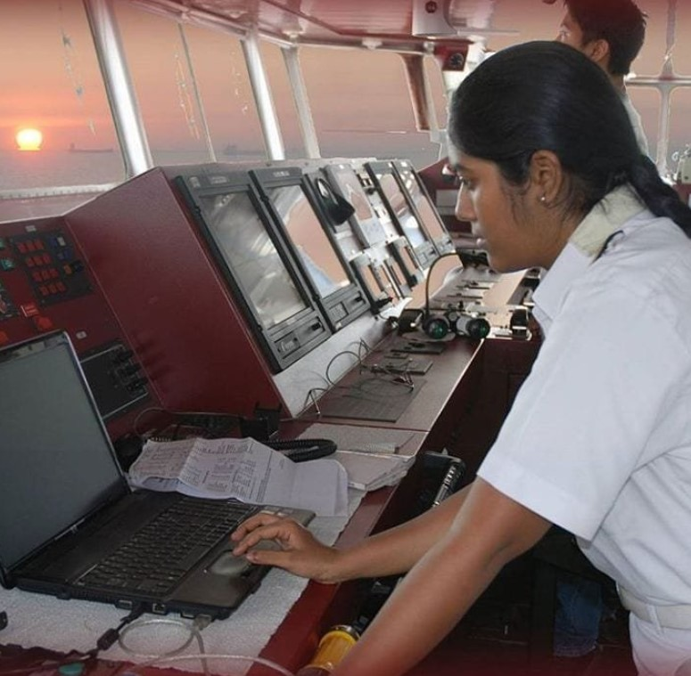
theseafarerscharity.org

Slide 23
What provision do women need/want
Personal face to face interaction (sometimes prefer to interact with women)
Digital links with women who have had experience at sea and can offer support/counselling
Products in seafarers’ centres that meet their needs (menstrual and beauty, clothing and souvenirs)
Access too bulk sanitary disposal facilities
Access to facilities catering for women
Information about available port-based support and facilities which are targeted to their needs
NB it is important that women are not doubly penalised for their minority status – on board AND in terms of port-based provision for their needs.
theseafarerscharity.org

Slide 24
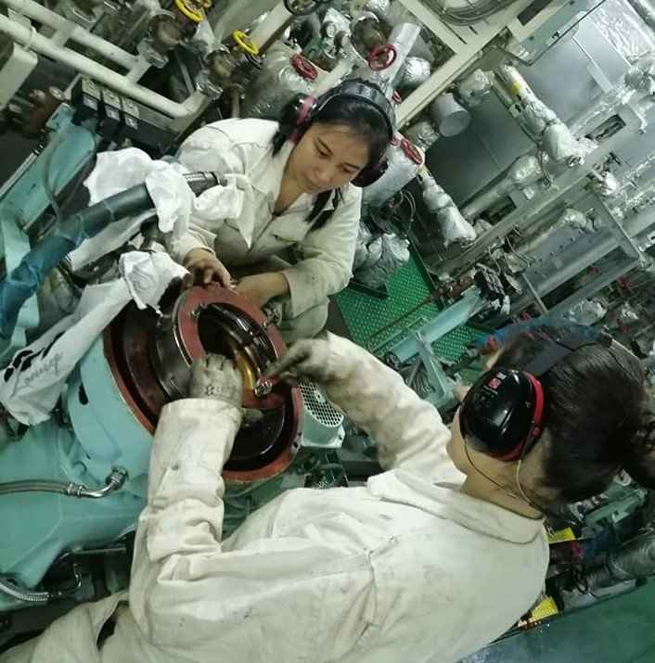
theseafarerscharity.org

Slide 25
Thank you for supporting the welfare of women at sea

